Slide 1
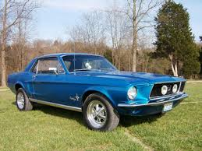
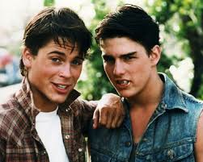
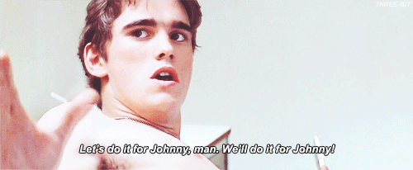
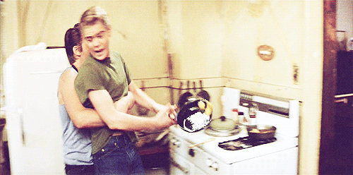
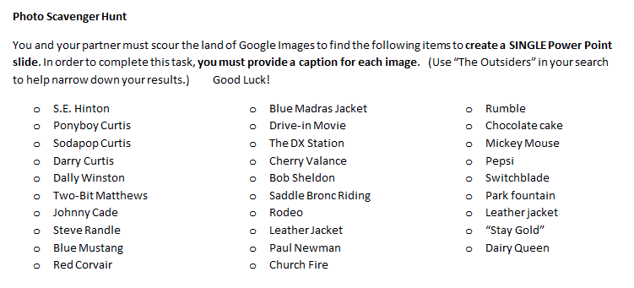
The Outsiders
Blue Mustang
Dally Winston
Sodapop & Steve
Photo Scavenger Hunt:
Create a single slide with as many of these items as you can. Be sure to label your photos. (tip: add a gif or blingee to make your slide more exciting)
Two-Bit & Pony
✓
✓
Drive-in movie
✓
✓
✓
✓
✓
✓
✓

