Slide 1
Using Adjectives
Adjectives: describe nouns

Slide 2
Adjectives make our language more descriptive.
Miss Lewis asked Santa for a pair of boots. However, Miss Lewis is very picky. The boots must be:
In your notebook, complete the following sentence by putting the adjectives in the correct order:
All Miss Lewis wants for Christmas is a pair of ______ ______ ________ _________ boots.
Italian
vintage
leather
black

Slide 3
Image you really want to buy a dog, so you head over the the pet store.
This pet store has hundreds of different dogs.
Simply saying, “I’d like a dog,” doesn’t describe what kind of dog you want.
This is where you can use adjectives to be more descriptive.

Slide 4
Adjectives describe nouns.
Think of all the adjectives to describe the dog you want to buy.
big or small?
Would the dog be
old or young?
shy or outgoing?
List 4 adjectives to describe the dog you’d like.
Share & add 3 additional adjectives to your list.

Slide 5
Let’s say you want a dog that is white and big.

Slide 6
Putting Adjectives in Order
When you use more than one adjective, you have to put them in the right order or your sentence will sound very strange.
For example, would you say,
“I want a big white dog?” or “I want a white big dog?”
The first one is correct. Why? Let’s look at our anchor chart

Slide 7
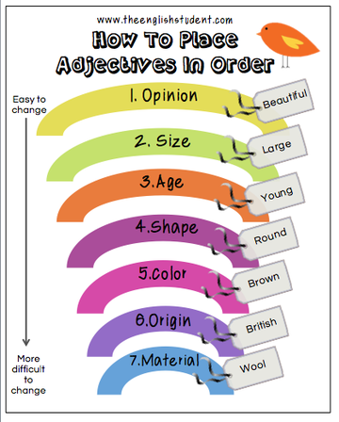
How to Place Adjectives in Order
“big” describes size (2)
“white” describes color (5)
According to the anchor chart, size comes before color so “a big white dog” is correct.

Slide 8
Task: Use four adjectives from your list to write a sentence describing the kid of dog you want.
Use use adjectives from different categories and place your adjectives before the noun (dog) being described.
Example:
I would like a ....dog.

Slide 9
Picture your close friends and family members. What adjectives would you use to describe each person?
Use three adjectives to describe each person. Be sure to put them in the correct order.
For example: My grandmother is a sassy eighty-nine year-old black woman.
Now it’s your turn (Choose 1):
A Female figure in your life
A Male figure in your life
A friend.

Slide 10
Work it out
1. Joe is a(n) (American / young / tall) basket ball star.
Joe is a tall young American basket ball star.

Slide 11
Work it out
2. I want to buy my brother a (funny / red) mug for Christmas.
I want to buy my brother a funny red mug for Christmas.

Slide 12
Work it out
3. My mother just bought a (blue / long / beautiful / new) dress for herself.
My mother just bought a beautiful long blue dress for herself.

Slide 13
Let’s look back…
4. All Miss Lewis wants for Christmas is a pair of (Italian / vintage / leather / black) boots.
All Miss Lewis wants for Christmas is a pair of vintage black Italian leather boots.

