Slide 1
Making Inferences

Slide 2
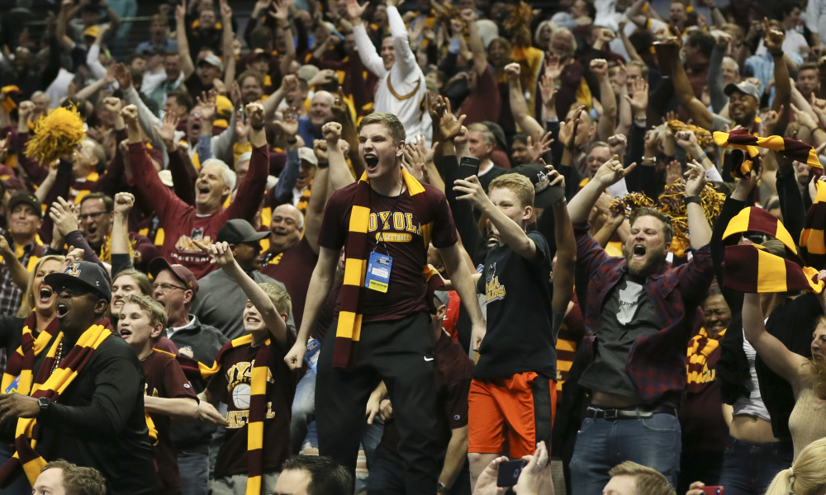
What can you infer is gong on in the picture?
What clues support your inference?

Slide 3
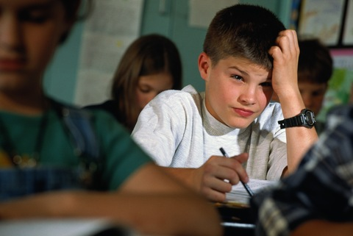
What can you infer is gong on in the picture?
What clues support your inference?

Slide 4

What can you infer is gong on in the picture?
What clues support your inference?

Slide 5
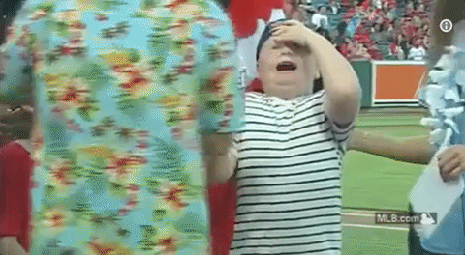
What can you infer is gong on in the picture?
What clues support your inference?

Slide 6
What can you infer about why Max is upset?
What clues support your inference?
Crack! Thunder struck and rain poured. Max stared blankly out the window, trying to contain his emotions that raged like the weather. He was beginning to lose it. Dropping the kite from his hand, Max broke out into full sobs. His mother comforted him, “There, there, Max. We’ll just find something else to do.” She began to unpack the picnic basket that was on the counter and offered him a sandwich. Max snapped, “I don’t wanna sand-mich!” A flash from the sky lit up the living room. Boom! Mom sighed.

Slide 7
What can you infer about what tommy has been doing?
What clues support your inference?
“Tommy!” Mom called out as she walked in the front door. “Tommy,” she continued shouting, “I sure could use some help with these groceries. There was still no reply. Mom walked into the kitchen to put the grocery bags down on the counter when she noticed shattered glass from the picture window all over the living room floor and a baseball not far from there. “I’m going to kill you, Tommy!” Mom yelled to herself as she realized that Tommy’s shoes were gone.

Slide 8
What can you infer about How Veronica feels about the two boys?
What clues support your inference?
The students in Mr. Pooper’s class were putting the finishing touches on cardboard mailboxes. After coloring a cool flame on the side of his racecar mailbox, Johnny hopped off his chair, strutted over to Veronica’s desk. He dropped a small white envelope into her princess castle mailbox and Veronica blushed and played with her hair. Meanwhile, Bartleby was frantically trying to put a small white envelope into everyone’s mailbox. After giving one to Mr. Pooper, Bartleby pulled out a medium-sized red envelope from his pocket. He blushed and tried to put it in Veronica’s mailbox, but it wouldn’t quite fit. Bartleby struggled with it for a few seconds and then ran off with the envelope. Veronica rolled her eyes and popped her gum.

