Slide 1
M1 U1 L10 & 11
Mid-Unit 1 Assessment
Vocab & Point of View

Slide 2
Let’s revisit Ch. 8 to review our Learning Target:
The girls second-guess their actions so far and worry Mama is in trouble with the FBI and police.
They try to get to Abuelita’s house so they can call Mama.
Their car breaks down and they start walking.
They become entranced by Cecilia—a woman who lures them into her house and offers them rest, sweets to eat, and beautiful clothing.
They see on a news report that the investigation to find them is underway and getting closer.
Odilia realizes something is not right but has become very drowsy from the sweets that Cecilia gave.
Odilia calls out for La Llorona as she begins to fall asleep.

Slide 3
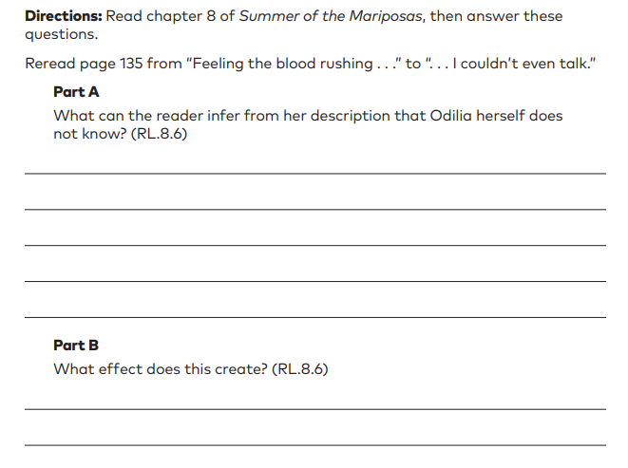
Learning Target: I can explain the effect created by differences in points of view.
Remember, when we analyze the effect created by differences in points of view we must:
Success Criteria:
Explain the point of view from the 1st perspective (in this case the reader)
Explain the point of view from the 2nd perspective (in this case Odilia)
Explain how these differences create an effect (suspense, humor, conflict, tension…) using cited or paraphrased text evidence.
Look at the example prompt on page 44.

Slide 4
Module 1, Mid-Unit 1 Assessment
Chapter 9 Synopsis:
La Llorona appears to Odilia, helps her see Cecilia is a sorceress, and gives her a remedy to break the spell.
Odilia helps the girls wake up from the spell Cecilia cast on them.
Odilia uses the ear pendant one more time, forcing Cecilia to give them information about how to get to Abuelita's house.
Cecilia is transformed into an ugly old woman and Velia, Delia, and Juanita taught Cecilia for her appearance.
In anger, Cecilia puts a curse on them declaring the rest of the journey difficult and full of trials.
The sisters escape Cecilia's house, with directions to the seer Teresita's home.
Learning Targets:
I can determine the meaning of words and phrases using context and word parts (prefixes, roots and suffixes).
(Craft & Structure LTa and Vocabulary LTa)
I can explain what effect is created by differences in the points of view of the characters and the reader.
(Key Ideas & Detail LTa and Craft & Structure LTc)
Let’s reread a couple excerpts to prep for our assessment:
Pages 143-145 & 152-158. You will need to use text evidence from these excerpts to explain how differences in points of view create tension in the story.

Slide 5
Learning Targets:
I can determine the meaning of words and phrases using context and word parts (prefixes, roots and suffixes). (Craft & Structure LTa and Vocabulary LTa)
I can explain what effect is created by differences in the points of view of the characters and the reader. (Key Ideas & Detail LTa and Craft & Structure LTc)
Materials Needed:
A copy of the text
Your Affix List (found on pages 226-233 of your Unit 1-3 book
Remember, when we analyze the effect created by differences in points of view we must:
Success Criteria for question :
Explain the point of view from the 1st perspective (question 8A)
Explain the point of view from the 2nd perspective (question 8B)
Explain how these differences create an effect (tension…) using cited or paraphrased text evidence. (question 8C)

