Slide 1
M1 U1 L06/07
Chapters 4 & 5
I can explain how the author develops points of view

Slide 2
Today we are going to read chapters 4 & 5. Please turn to page 20 in your book.

Slide 3
Chapter Synopsis
Chapter 4
• Nya stops at home for a bowl of boiled sorghum meal and then returns to the pond with her little sister Akeer.
• Salva leaves the old woman’s house.
• He joins a new group of people escaping, and they don’t want to include him as he’s another mouth to feed until a woman stands up for him.
• Unfortunately, no one from his family is with the group.
• Salva walks with a young man named Buksa, who leads the group to a beehive filled with honey
Chapter 5
• Nya’s family moves to an area beside a lake.
• Nya’s tribe, the Nuer, take a break from fighting their rival tribe, the Dinka, because both tribes are busy trying to survive the dry season.
• Nya must dig a hole and wait for water, for hours at a time.
• Salva meets a new friend named Marial.
• Salva and Marial walk together in lion-country and connect over their missing families.

Slide 4
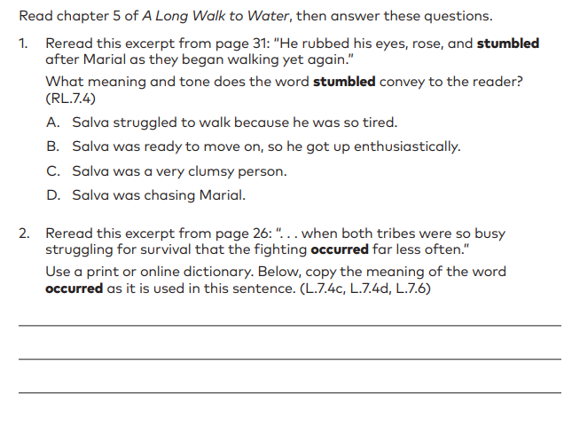
Let’s do some more vocabulary and point of view practice to get ready for our Mid-Unit Assessment.
Learning Targets Assessed:
I can determine the meaning of new words by using context or word parts.
I can explain how the author develops points of view.
Turn to page 30 in your workbook

