Slide 1
I can identify strategies to answer selected response questions.
(Key Ideas & Details LTa)
I can find the gist of chapter 2 of Summer of the Mariposas.
(Key Ideas & Details LTc)
I can explain what effect is created by differences in the points of view of the characters and the reader in the chapter 2 excerpt of Summer of the Mariposas.
(Craft & Structure LTc)

Slide 2
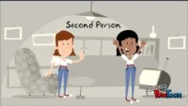
Point of View: in narrative texts, the narrator's position in relation to the story being told; it shows the opinions or feelings of the characters involved in a situation; it is what the author allows the reader to "hear" or "see" what is happening.

Slide 3
Today we are going to read excerpts (sections) of Chapter 2. Follow along as we read pages 32-36 and page 43
Learning Target: I can explain what effect is created by differences in the points of view of the characters and the reader.
Chapter 2 Vocabulary:
Presumed - to take for granted, assume, or suppose
Decisively - in a manner that settles an issue convincingly or produces a definite result
Spitefully - showing or caused by malice
Flounced - move in an exaggeratedly impatient or angry manner
ESP - extrasensory perception; the ability to know things (such as what a person is thinking or what will happen in the future) that cannot be known by normal use of senses

Slide 4
Learning Target:
I can find the gist of chapter 2 of Summer of the Mariposas.
(Key Ideas & Details LTc)
Synopsis: Summer of the Mariposas Chapter 2
Chapter 2
Odilia’s sisters begin packing for Mexico, but Odilia has a different plan.
Odilia tries to tell Mama about the girls’ plan and is unsuccessful.
Odilia tries to trick her sisters into believing that their mother is home.
The girls sneak out of the house at night in Papa’s old car, planning to leave without Odilia.
Odilia reluctantly joins them instead of letting her sisters go by themselves.
Turn to page 8 in your workbook. In the blank space, write the gist of chapter 2. (1-2 sentences) Use the synopsis to help you formulate your response.

Slide 5
Learning Target: I can explain what effect is created by differences in the points of view of the characters and the reader in the chapter 2 excerpt of Summer of the Mariposas.
Point of view is the way the author allows the reader to “hear” and “see” what is happening.
Authors often create differences between different characters’ points of view, as well as your point of view as a reader. Different characters have different feelings and opinions about what is going on, and so do readers.
These differences in point of view between characters and the audience can create different effects, such as suspense or humor.
How does the author use differences in the points of view of the characters and the reader to create effects like suspense or humor?
• Using the first person point of view, the author enables the reader to see some events that the other characters don’t see.
• The author reveals to the reader what the narrator is thinking or feeling that the characters in the novel don’t know.
• We feel the feelings of the narrator.

Slide 6
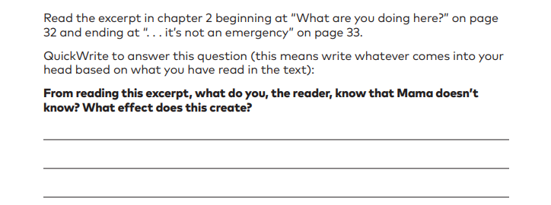
Learning Target: I can explain what effect is created by differences in the points of view of the characters and the reader in the chapter 2 excerpt of Summer of the Mariposas.
Let’s turn to pages 9 & 10 to practice how we address this Learning Target.

Slide 7
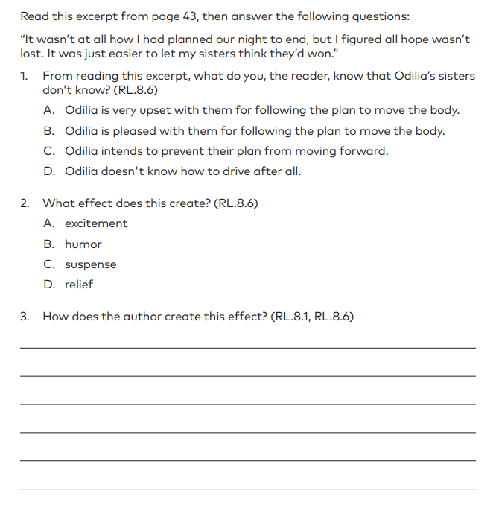
It wasn’t at all how I had planned our night to end, but I figured all hope wasn’t lost. It was just easier to let my sisters think they’d won. However, the instant I buckled up I promised myself I’d surrender the body when we got to the international bridge — no matter what. (43)

