Slide 1
I can identify strategies to answer selected response questions.
I can analyze how the setting shapes the characters and plot in chapters 1 and 2 of A Long Walk to Water. (Key Ideas & Details LTa, LTc)
I can explain how the author developed Salva's and Nya's points of view of life in chapter 2 of A Long Walk to Water. (Craft & Structure LTc)
M1 U1 L04
Explain how the author develops points of view

Slide 2
Follow along in the text as we read Chapter 2.
Vocabulary
• mortars (12): short guns used for firing shells (technically called bombs) at high angles

Slide 3
What is the gist of Chapter 2?
Record your answer on page 9
Synopsis of Chapter 2:
• Nya is jabbed in the foot by a thorn.
• Salva runs and walks for a long time.
• Other people are walking, too.
• They organize by village, but no one from his family is there.
• They arrive at the rebel camp, and the men are forced to go with the rebels.
• The women and children sleep in a barn that night.
• Salva is left all alone; the others walk on without him.
Nya’s Part | Salva’s Part
Nya had to take a thorn our of her foot
Salva is walking with a group; not his family, soldiers take men & leave him behind

Slide 4
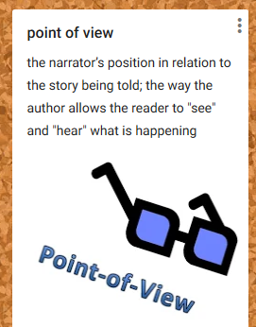
The point of view in narrative texts is the narrator’s position in relation to the story being told. It shows the opinions or feelings of the individuals involved in a situation. Point of view is the way the author allows the reader to “hear” and “see” what is happening.
Point of view focuses on who is telling the story or who is speaking. The ways in which one’s perspective about or attitude toward a subject is revealed depends on how the author develops the speaker’s point of view.
Author: the person who wrote the text
Narrator: the character or speaker telling the story
First person point of view: Comes from the perspective of a character in the story; uses the pronouns I, me, and my; character tells the story as it’s happening, or recalls a story that happened in the past.
Third person point of view: Not told by a character in the story; uses the pronouns he, she, and they. Reader might know information that not all characters know.

Slide 5
As you continue to read A Long Walk to Water, think about point of view.
Here are some examples of different points of view along with evidence.
What is Nya’s point of view about the thorn in her foot?
What is Salva’s point of view when he starts to join the men’s group and a soldier raises a gun towards him?
It is painful, but she wants to be brave.
How do we know this?
She presses her lips together.
How do we know this?
He wants to be brave and “act like a man” as his father told him to.
Salva remembers his name and what it means. He thinks about this family when the soldier raises the gun.

Slide 6
Learning Target: I can analyze how the setting (when and where the story takes place) shapes the characters and plot in chapter 1 and 2 of A Long Walk to Water.
Turn to page 8 in your workbook.
Which answer best defines the word shapes in the following learning target?
I can analyze how the setting shapes the characters and plot in chapters 1 and 2 of A Long Walk to Water.
A. to give a certain form or shape to; mold
B. an ordered or organized form
C. to give a direction or character to
D. physical condition

Slide 7
Learning Target:
I can analyze how the setting shapes the characters and plot
Please turn to page 10

Slide 8
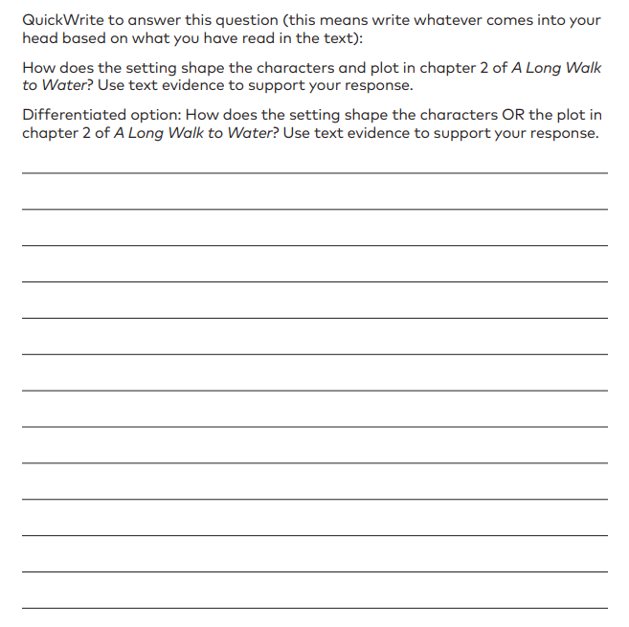
How do we formulate a response?
Identify the setting: The setting in chapter 2 is…
State an event: In this setting, Nya has to…
Provide evidence w/ page: In the text it says, “….”
Explain how the setting shapes (characters/plot): This shows that Nya is…
Example – How does the setting shape a character?
The setting in chapter 2 is southern Sudan in 2008. The setting is dry and dangerous. Nya has to walk a long way on a dry, dangerous path. The text states that “spiky plants grew along the path” and “their thorns littered the ground everywhere” (8). This shows that Nya has to overcome obstacles in a harsh setting.

Slide 9
Let’s try one together:
How does the setting shape the plot of Salva’s story in chapter 2?
How do we formulate a response?
Identify the setting: The setting in chapter 2 is…
State an event: In this setting, Nya has to…
Provide evidence w/ page: In the text it says, “….”
Explain how the setting shapes (characters/plot): This shows that Nya is…

