Slide 1
Welcome to 8th Grade ELA

Slide 2
Unit 1 Lesson 1 – Discover Our Topic
Summer of the mariposas

Slide 3
I can infer the topic of this module from the resources.
(Key Ideas & Details LTa)
Today We Will: Opening Work Time A. Infer the Topic B. Introduce the Performance Task C. Introduce the Work to Become Ethical People Anchor Chart Closing and Reflecting: Reflect on Learning Targets Homework: Preread Summer of the Mariposas, Chapter 1

Slide 4
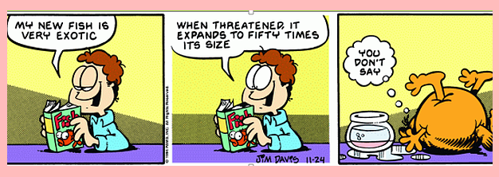
inference
What do you think infer means?
When we make an inference, we make a good guess based on the evidence we have seen.
If we are going to infer the topic, what does that mean?
Inferring topics means making a good guess about the topic based on the content of the resources we will look at.

Slide 5
Open to page 3 of your Unit 1 Workbook.
Record your thinking on your Note-Catcher

Slide 6
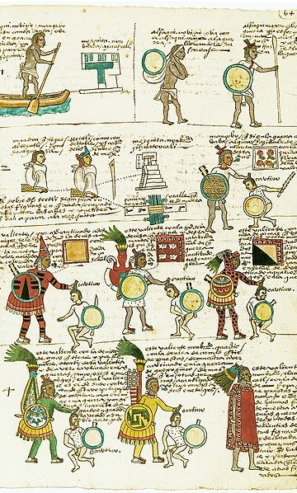
I Notice...I Wonder
What do you see?
What questions come to mind?
There are no wrong answers!
Doing this activity is helpful to understand and explore a new topic or text.
"Codex Medoza." Illustration. 16th century. Bodleian Library. Wikimedia. Web. Public Domain.

Slide 7
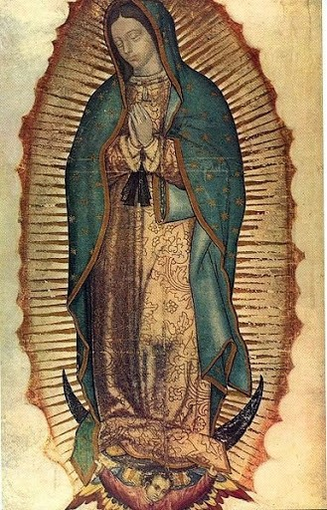
Virgin Mary
Mayo & Weed. "Virgin Mary". Photograph. 1898. The Miriam and Ira D. Wallach Division of Art, Prints and Photographs: Photography Collection, The New York Public Library. The New York Public Library Digial Collections. Web. Public Domain.

Slide 8
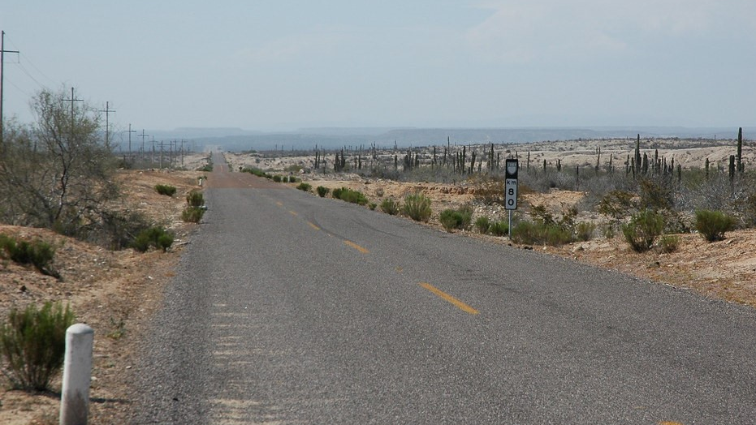
Highway 80
Wonderlane. "Endless desert highway 80, Baja California Sur, Mexico." Photograph. Flickr. 21 May 2009. Web Used under CC BY 2.0.

Slide 9
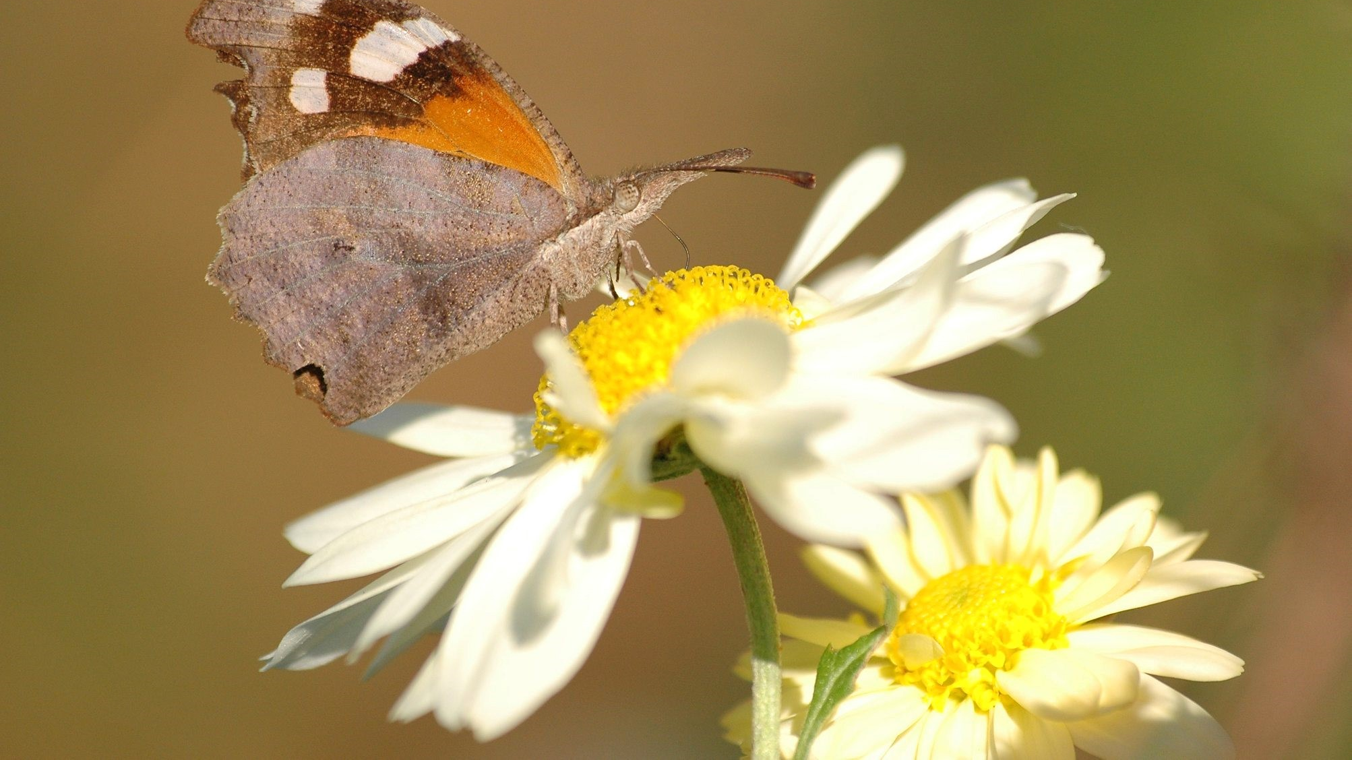
Mariposa
Ospr3yy. "American Snout." Photograph. Wikimedia. 22 Nov. 2010. Web. Used under Free Art License 1.3

Slide 10
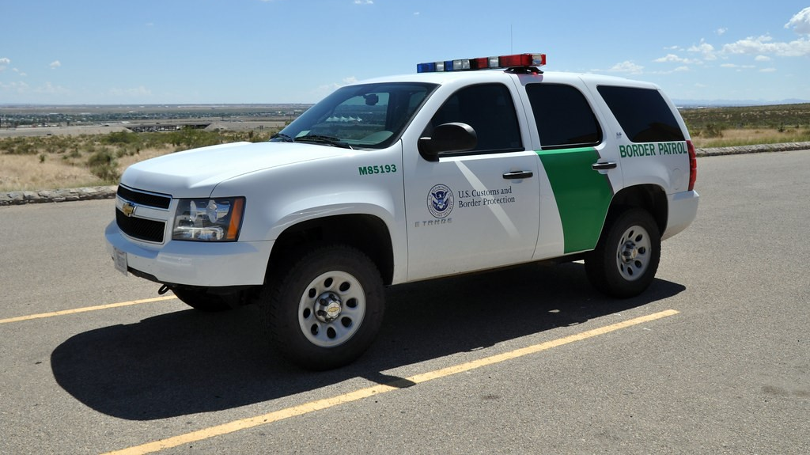
Border Patrol
Johnathan McIntosh, "Border Patrol Museum." Photograph. Flickr. 15 Sep. 2009. Web USed under CC BY 2.0.

Slide 11
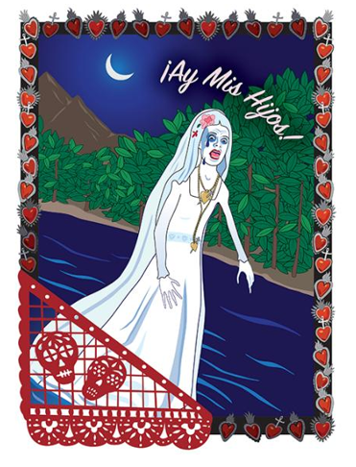
La Llorona

Slide 12
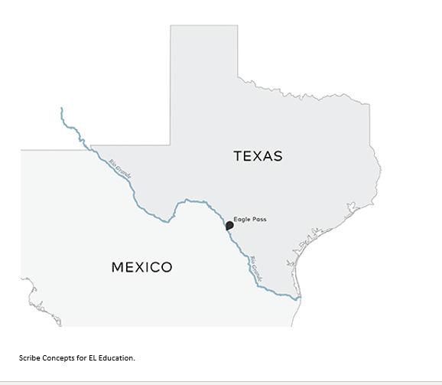
Eagle Pass

Slide 13
Answer the following questions…
As you were looking through the images, what were some of the things you thought about or had questions about regarding these images?
Now that you have looked at some of the resources, what do you think this module might be about?
What evidence supports your inferences?

Slide 14
Guiding Questions & Vocabulary for this Module
Why do we see evidence of myths and traditional stories in modern narratives?
How and why can we modernize myths and traditional stories to be meaningful to today’s audiences?
Academic Vocabulary: Myth - a popular story from the past that uses supernatural beings and events to explain a practice, belief, or natural events. Traditional - passed down and unwritten; ritual Narrative - a story Modernize - to make new and different or suitable for the present time. Folklore - the traditional beliefs, customs, and stories of a community, passed through the generations by word of mouth.

Slide 15
So what are we reading?
Please preread Chapter 1 of Summer of the Mariposas to prepare you for the next lesson.

Slide 16
Work to Become Ethical People Anchor Chart
Habit of character | I show respect.
What Does it Mean?
What Does it Look Like?
What does it sound like?
This means I appreciate the abilities, qualities, and achievements of others and treat myself, others and the environment with care
Applauding others when hey have done well
Taking care around the classroom not to break things or hurt people
Returning borrowed items in the same condition you were given them
Throwing trash in the trash can
Recycling
“I really appreciate…because…”
“You did a great job with…because…”

Slide 17
Work to Become Ethical People Anchor Chart
Habit of character | I behave with integrity.
What Does it Mean?
What Does it Look Like?
What does it sound like?
This means I am honest and do the right thing, even when it’s difficult, because it is the right thing to do.
Admitting when at fault
Doing homework
Keeping eyes on own work
“I’m sorry, but I…”

Slide 18
Work to Become Ethical People Anchor Chart
Habit of character | I show empathy
What Does it Mean?
What Does it Look Like?
What does it sound like?
This means I understand and I share or take into account the feelings, situation, or attitude of others.
Listening carefully and showing the appropriate facial expressions for the situation
“I understand how you feel.”
I can imagine how you feel.”

Slide 19
Work to Become Ethical People Anchor Chart
Habit of character | I show compassion
What Does it Mean?
What Does it Look Like?
What does it sound like?
This means I notice when others are sad or upset and try to help them.
Approaching a friend or classmate who looks upset
“You look upset, is everything OK? Is there anything I can do to help?”

