Slide 1
Chapter 2: Vocabulary Words
Defiance - a daring or bold resistance to authority or to any opposing force
Uprising - an act or instance of rising in revolt, rebellion, or resistance against civil authority or an established government
Revolution - an overthrow and the thorough replacement of an established government or political system by the people governed.

Slide 2
There’s a long pause while he examines me. Then he simply says, “It is fragile, but not in the way that you suppose.”
~ President Snow.
Katniss and President snow are looking at the state of Panem from two different perspectives. How are these two points of view different when it comes to the “fragile” state of Panem?

Slide 3
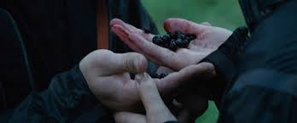
“I have a problem, Miss Everdeen,” says President Snow. “A problem that began the moment you pulled out those poisonous berries in the arena.” (page 20)
Turn to your neighbor:
Contrast how the people in the Capitol feel about the berry incident, with the way the people in the districts feel about it.

Slide 4
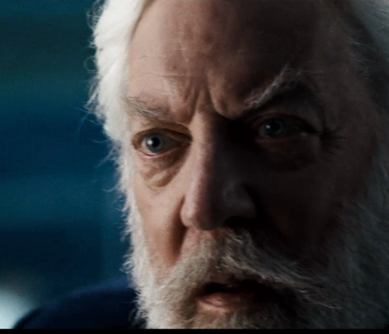
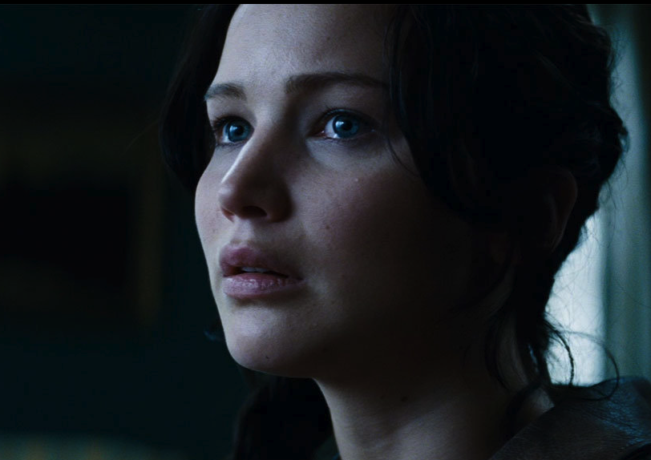
“This tour will be your only chance to turn things around… “Convince me.”
In your journal: Type 1 Reflection
Write 5 lines
What does Katniss need to prove on this Victory Tour? Why is it so important to President Snow that she is successful?

