Slide 1
Notes on THEME
Fill in the blank notes

Slide 2
What is a theme?
A theme is the lesson you can learn about life or human nature from the book or story.

Slide 3
The theme should be a life lesson that you can apply to your own life.

Slide 4
Themes should always be
stated in a complete sentence.

Slide 5
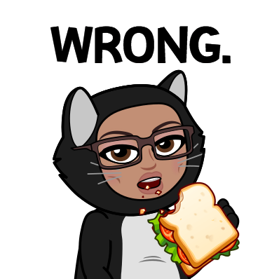
A theme is not...
A moral
A cliché (an overused expression such as "the grass is always greener on the other side" or "you don't always know what you've got until it's gone.")
A one-word subject or topic like "friendship" or "survival"

Slide 6
Themes must always be supported by
evidence from the text.

Slide 7
Determine if the following is a theme and explain your thinking.
Don’t judge a book by its cover.

Slide 8
Determine if the following is a theme and explain your thinking.
Don’t judge a book by its cover.
An expression is not a theme.
Instead, state what the expression means: People shouldn’t judge others based on appearance.

Slide 9
Determine if the following is a theme and explain your thinking.
You can’t fix the bad, but you can bring the good.

Slide 10
Determine if the following is a theme and explain your thinking.
You can’t fix the bad, but you can bring the good. The idea is there, but this statement does not make sense.
Themes need to be clearly stated: It is better to focus on the good in life rather than the negative things you cannot change.

Slide 11
Determine if the following is a theme and explain your thinking.
We can all do something that changes the world.

Slide 12
Determine if the following is a theme and explain your thinking.
We can all do something that changes the world.
Yes! Next step – back it up with evidence.

Slide 13
Determine if the following is a theme and explain your thinking.
Wendell bought a shovel.

Slide 14
Determine if the following is a theme and explain your thinking.
Wendell bought a shovel.
This is a summary of an event. Themes are lessons learned from an experience.

Slide 15
Determine if the following is a theme and explain your thinking.
Don’t judge people if you don’t know their whole story.

Slide 16
Determine if the following is a theme and explain your thinking.
Don’t judge people if you don’t know their whole story.
Yes! Clear, makes sense, and we can all relate to this lesson.

Slide 17
Determine if the following is a theme and explain your thinking.
When people work together, it can become a big thing.

Slide 18
Determine if the following is a theme and explain your thinking.
When people work together, it can become a big thing.
Close. Could this be stated more clearly?
People can accomplish more when they work together.

Slide 19
Read over the following list. Which statements stand out to you? Are those statements themes or not?
1. Stereotyping is bad and a very rude thing.
2. He made a mistake when he cheated on his girlfriend, but now he will try anything to win her back.
3. Sometimes when you help others, you help yourself in the process.
4. You can get over anything even if it’s the worst thing ever.
5. Accept yourself and the life you’ve been given.
6. Forgive and forget.
8. The grass is always greener on the other side.

