Slide 1
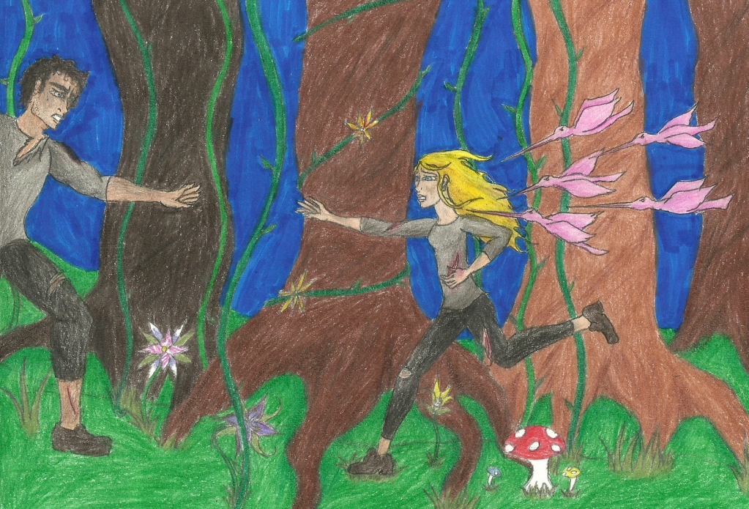
The 50th Anniversary Quarter Quell
1. After you read Chapter 14, Complete the green foldable in your notebook.
Watch a depiction of the second Quarter Quell
http://www.youtube.com/watch?v=7mUjssn86h4
2. In Your Notebook: After watching the depiction, how do you think it compares to the novel version? List all the similarities and differences between the two.

