Slide 1
ped- = foot
Greek & Latin Roots

Slide 2
A root is the base of a word
The root “ped” has to do with foot.
All of the words we will study this week have something to do with feet.

Slide 3
Ped/pod = foot
pedestrian millipede peddler tripod pedicure centipede quadruped pedal impediment biped

Slide 4
Team Sort
Set your word list where everyone can see and distribute definitions evenly to group members.
Starting with the person wearing the most red –
Read one of your definitions out loud to the group.
As a group, decide which word best matches the definition. If you disagree, explain why you fill your definition choice is the best. Once you’ve agreed, place the definition next to the correct word.
Move clockwise to the next person and repeat the process.
Proceed around the group reading one definition at a time until all words and definitions have been matched correctly.

Slide 5
Ped/pod = foot
Pedestrian – a person who walks across the street on foot
Millipede – a creature with 1,000 feet
Peddler- a person who goes from door to door on foot trying to sell a product
Tripod – a three-footed stand often used to balance a camera
Pedicure – a foot treatment that could include soaking the feet and polishing the toenails
Centipede – a creature with 100 feet
Quadruped – a four-footed creature
Pedal – a lever that is moved with one’s feet
Impediment – something that stands in one’s way; an obstacle
Biped – a creature with two feet

Slide 6
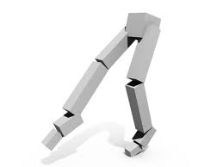
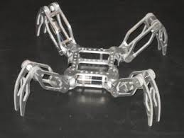
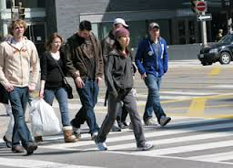
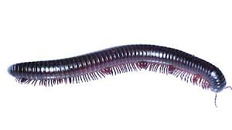
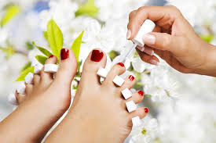
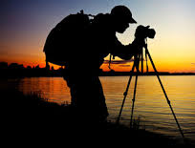
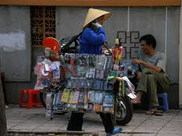
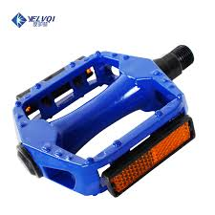
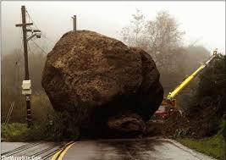
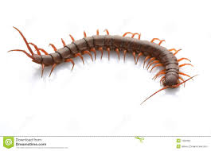
Ped / Pod = foot or feet
Biped
Centipede
Impediment
Millipede
Pedal
Peddler
Pedestrian
Pedicure
Quadruped
Tripod

Slide 7
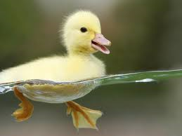
Definition – written in a complete sentence.
Illustration
A creature that uses two feet for walking.
biped
word
Word used in a sentence
Relationship to foot
The duckling is a biped that can walk on land and uses its webbed feet to quickly glide through water.
Biped is related to feet because bi means two and ped means foot or feet. A biped had two feet.

Slide 8
Choose 2 words to examine
Success Criteria:
Word is defined correctly
Illustration makes sense
Sentence uses word correctly and makes sense.
Clear connection is made between the word and the root
Definition
Illustration
A creature that uses two feet for walking.
biped
word
Word used in a sentence
Relationship to foot
The duckling is a biped that can walk on land and used its webbed feet to quickly glide through water.
Biped related to feet because bi means two and ped means foot or feet. A biped had two feet.

