Slide 1
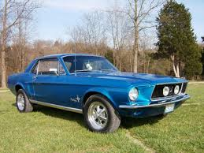
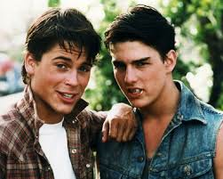
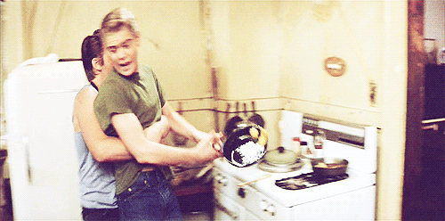
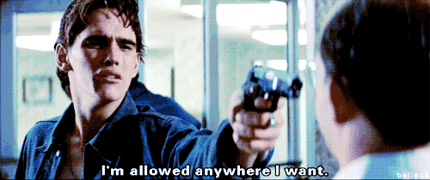
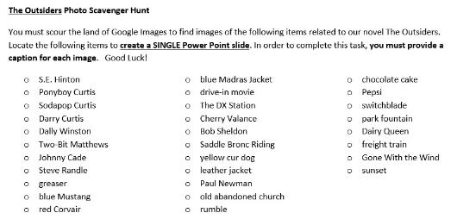
The Outsiders
Blue Mustang
Sodapop & Steve
Drive-in movie
Photo Scavenger Hunt:
Create a single slide with as many of these items as you can. Be sure to label your photos. (tip: add a gif or blingee to make your slide more exciting)
Two-Bit & Pony
Dally Winston

Slide 2
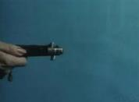
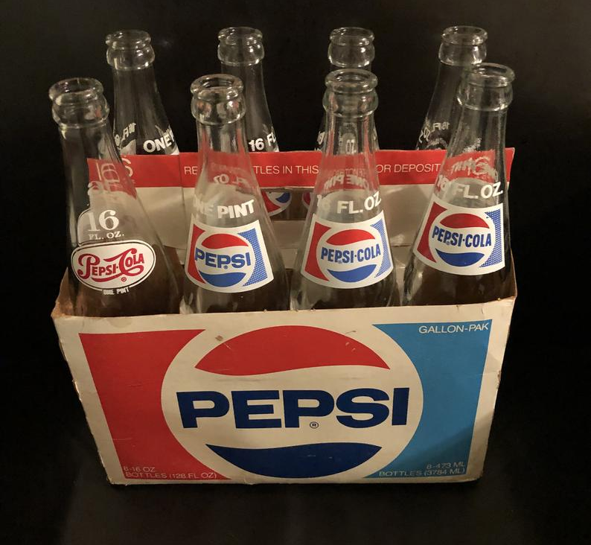
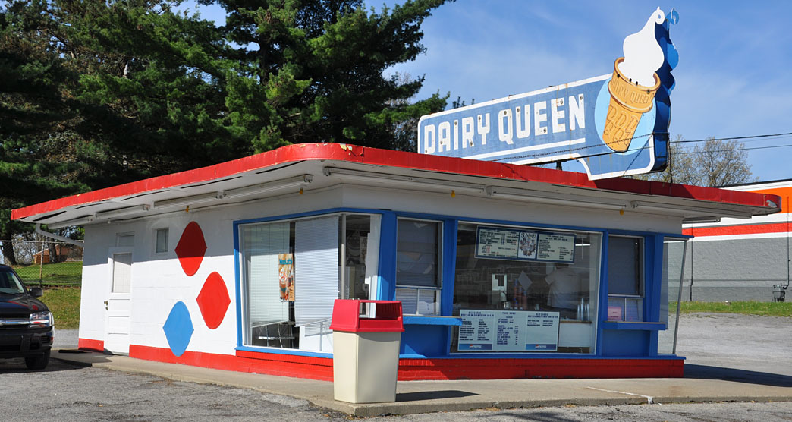
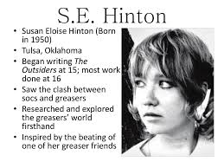
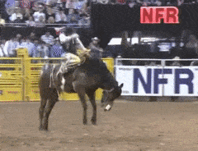
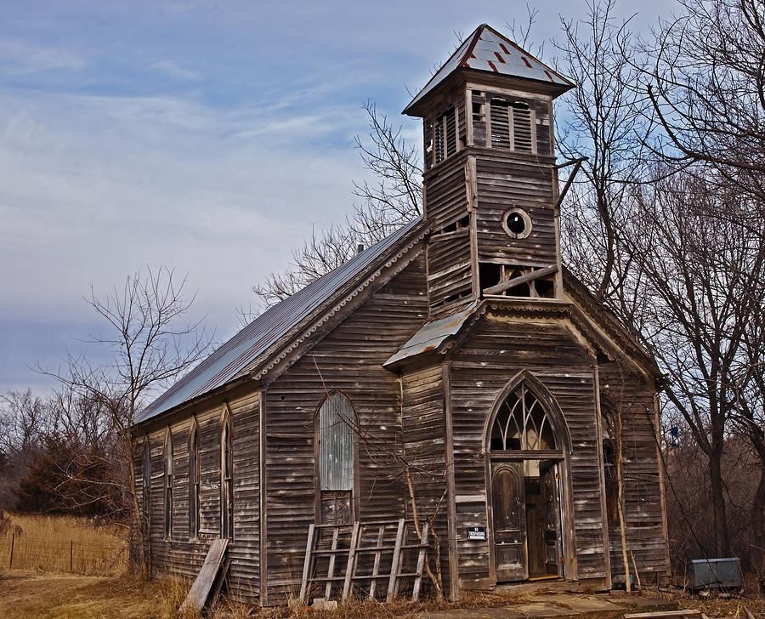
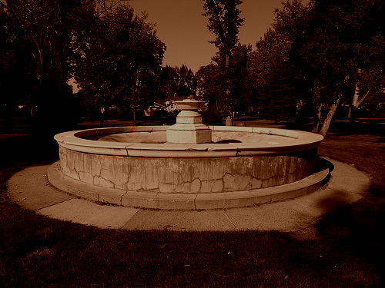
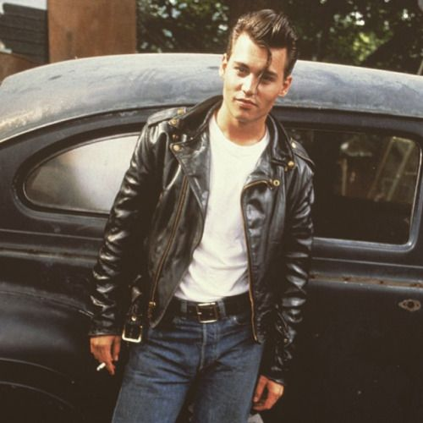
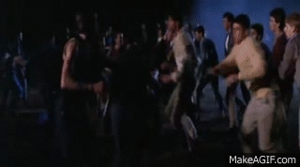
The Outsiders
Blue Mustang
Sodapop & Steve
Drive-in movie
switchblade
yellow cur dog
Two-Bit & Pony
Dally Winston
saddle bronc riding
old abandoned church
park fountain
sunset
greaser

