Slide 1
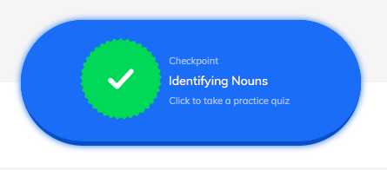
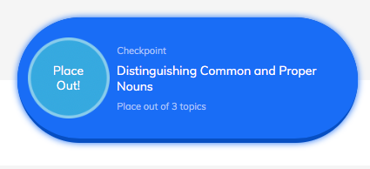
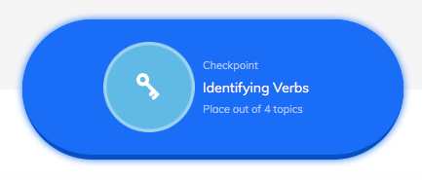
No Red Ink: Back to Basics I
You must complete all 3 topics.
Noun = person, place thing or idea
Concrete = things you can see, taste, touch, smell
Examples = dog, school, chair, Mr. Smith, Taco Johns
Abstract = ideas/concepts
Examples = freedom, talent, happiness, religion
1. Identifying Nouns
2. Distinguishing Common and Proper Nouns
Proper nouns = name specifics nouns
Examples of proper nouns = Hoyt Middle School, Miss Lewis, Charles Barkley, Hubble Avenue
Common nouns = nonspecific nouns
Examples of common nouns = school, teacher, dog, street
Verb = what someone or something does
Examples = dances, cooked, play
Certain verb tenses require verb phrases with helping verbs
Examples = has eaten, will be finished, will have been reading
3. Identifying Verbs

