Slide 1
Figurative Language
M1 U1 L10

Slide 2
Figurative Language
Verbal Irony: using language that means to opposite of what you mean for humor or effect
Imagery: language that creates a mental image for the reader, using sensory descriptions
Simile: a comparison of two unlike things using "like" or "as"
Pun: a play on words based on two words that are close in sound but different in meaning
Personification: giving an inanimate object human-like qualities
Hyperbole: use of exaggeration to emphasize a point
Metaphor: a comparison of two unlike things

Slide 3
Turn to page 32 in your workbook.
Let’s explore our learning target together: I can determine the meaning of figurative language.

Slide 4
Chapter 6 Recap – what we’ve read
The girls arrive in El Sacrificio and ask for directions to the drowned man’s house.
La Llorona appears to Odilia again and warns her that she will have to face her fears.
They arrive during a quinceañera at the house of the drowned man, and the girls do not want to share the news of the drowned man’s death.
Relatives see the drowned man in the car and don’t realize he is dead at first.
Once they realize he is dead, the birthday celebration turns into a wake.
Chapter 7 Synopsis (what we skipped)
The girls spend the night at the house of the dead man’s wife, Ines.
Odilia tell Ines’ family that they are heading to visit their abuela in the morning.
Ines’ family is concerned and suggests the girls call home.
Odilia uses her ear pendant a second time to hypnotize Ines’ family when they suggest calling the girls’ relatives.
The girls realize they are in the newspaper headlines, which are reporting the Garza girls as missing.

Slide 5
Chapter 8 Excerpt: pages 129- the end
Brush - a pile or covering of lopped or broken branches
Affluent - rich
Forensic - describe scientific methods used to investigate crimes
Imperative - very important
Incoherent - unclear; confusing
Where we are pickup up on page 129…
The girls second-guess their actions so far and worry Mama is in trouble with the FBI and police.
They try to get to Abuelita’s house so they can call Mama.
Their car breaks down and they start walking.

Slide 6
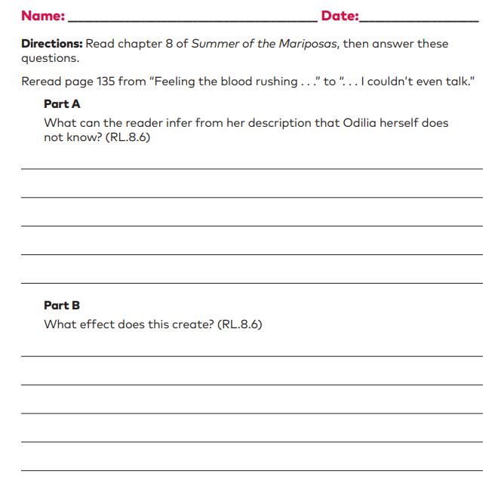
Learning Target: I can explain how differences in points of view create an effect. Let’s practice one more time before our assessment. Turn to page 44 in your Unit 1 Workbook.

