Slide 1
M1 U1 L07
Chapters 4-5

Slide 2
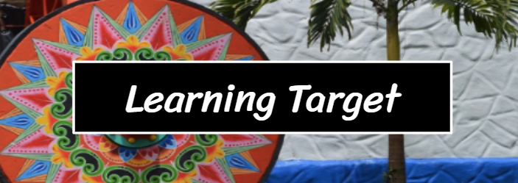
I can determine the meaning of new vocabulary by using context clues or word parts.
I can explain what effect is created by differences in the points of view of the characters and the reader

Slide 3
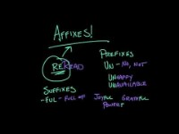
Affixes
Prefix – before
Suffix - after

Slide 4
Let's refer to our Learning Target: I can determine the meaning of new vocabulary by using context clues or word parts.
"I watched the road ahead for a good place to turn around, but when I looked back, the woman was gone. Disappeared, like she'd never been there."
Let's break down the word into three parts.
Prefix: A prefix is an affix which is placed before the stem of a word. Adding it to the beginning of one word changes it into another word.
Root: It is the most basic part of the word.
Suffix: A suffix is an affix which is placed at the end of the stem of a word.
Disappeared
Prefix: dis- means opposite of
Root: appear means to come in sight
Suffix: -ed means to make a word past tense
How did breaking down the word into affixes and roots help you determine the meaning?

Slide 5
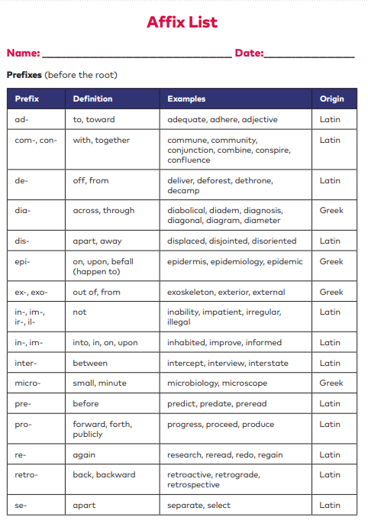
Each of you has your very own Affix List found on pages 226-233
Let’s use our list to explore some words.
Amorous
Root = amo which means:
Suffix = ous which means:
Therefore, amorous must mean:

Slide 6
Each of you has your very own Affix List found on pages 216-221
Let’s use our list to explore some words.
If someone goes to an arboretum, they are most likely going to look at what?
What does the root arbor mean?

Slide 7
Each of you has your very own Affix List found on pages 216-221
Let’s use our list to explore some words.
Divide the word inaudible into its parts.
prefix = which means:
root= which means:
suffix= which means:
Based on these word parts, inaudible must mean what?
If a person were an auditory learner, what could that mean?

Slide 8
Each of you has your very own Affix List found on pages 216-221
Let’s use our list to explore some words.
Sometimes a word has 2 roots or base words. What 2 roots make up the word hydrophobia?
root= which means:
root= which means:
Based on these word parts, hydrophobia must mean what?

Slide 9
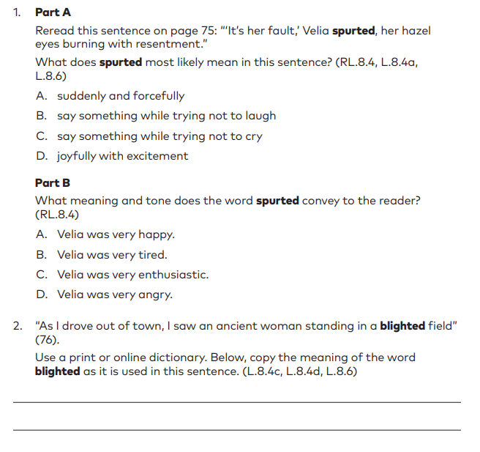
Let’s do some vocabulary practice together.
Turn to page 28 to get started.

Slide 10
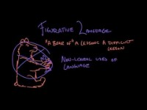
Figurative Language

Slide 11
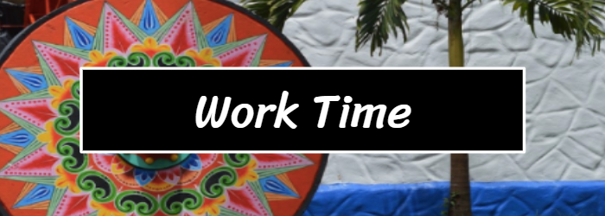
Synopsis: Summer of the Mariposas Chapter 4
The girls drive Papa’s car into Mexico.
Odilia decides to believe in the cinco hermanitas, herself and her sisters, and their mission, instead of fighting with them about it.
Odilia uses her ear pendant to distract the border attendant so that the girls can pass safely over the border.
They cross the border into Mexico without the border guards suspecting they are carrying a corpse and keep driving.
Synopsis: Summer of the Mariposas Chapter 5
The girls bribe an officer to be allowed past a checkpoint.
Pita is nervous about being away from home and protests that she is being kidnapped and wants to return home.
Pita’s complaints cause the girls to fight.
While Odilia goes to the store to get food for the girls, the other sisters tie Pita to a tree.
Odilia returns and defends Pita.
They eat and rest in a secluded area.

