Slide 1
I can identify strategies to determine (figure out) the meaning of unfamiliar vocabulary. (Vocabulary LTa)
I can analyze how the setting shapes the characters and plot in chapter 3 of A Long Walk to Water. (Key Ideas & Details LTa, LTc)
I can explain how the author develops the points of view of Salva and Nya in chapter 3 of A Long Walk to Water. (Craft & Structure LTc)

Slide 2
Learning Goal: What is the gist of a text.
Remember, this gist is what the text is mostly about. You tell the gist of the chapter with a very small number of words.
The gist of chapter 2:
Nya: takes thorn out of foot
Salva: walking with a group; not his family; soldiers take men; group leaves him behind

Slide 3
Turn to page 13 in your workbook. Under the synopsis of chapter 3, record the gist of the chapter.
Synopsis: A Long Walk to Water, Chapter 3
• Nya gets to the pond and fills her container.
• She begins the long walk home.
• Salva cries from loneliness.
• Salva stays with an old Dinka woman for a few days; Salva is from the Dinka tribe.
• The old Dinka woman asks him what he will do and where his family is, and he doesn’t know.
• The old woman must leave to get away from the fighting and to find water.
• She tells Salva she must go alone as it is safer for her that way.
• Salva hears voices, and he leaves with other Dinka walkers.
What is the gist of Nya's part?
What is the gist of Salva's part?

Slide 4
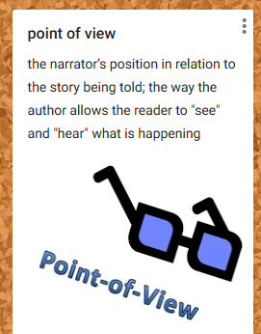

Slide 5
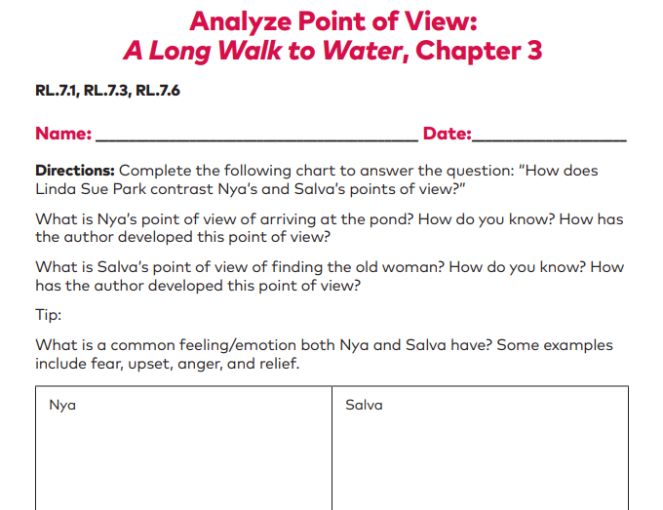
Learning Target: I can explain how the author develops the points of view of Salva and Nya in chapter 3 of A Long Walk to Water. (Craft & Structure LTc)
Let’s practice together. Turn to page 14 in your workbook.

Slide 6
I can identify strategies to determine (figure out) the meaning of unfamiliar vocabulary. (Vocabulary LTa)
No books today.
Please come in and grab your folder.
*Remember: our goal is to have a successful day – much better than yesterday, please.

Slide 7
I can identify strategies to determine (figure out) the meaning of unfamiliar vocabulary. (Vocabulary LTa)
One strategy is to use word parts: roots and affixes (prefixes and suffixes).
The root of the word gives the main meaning.
A prefix comes before the root
A suffix comes after the root.
Example: rereading
re = again
read = to look at and understand text
-ing =an ongoing action
When we are rereading something, we are reading it again right now.

Slide 8
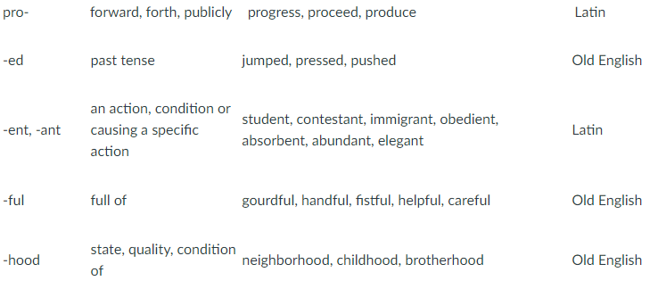
Here are just a few common prefixes and suffixes

Slide 9
What do we mean by “word parts”?

Slide 10
Affixes
Prefix – before
Suffix - after

Slide 11
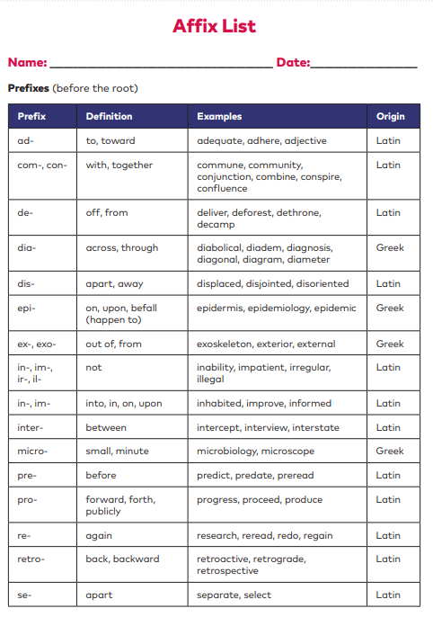
Each of you has your very own Affix List found on pages 216-221
Let’s use our list to explore some words.
Amorous
Root = amo which means:
Suffix = ous which means:
Therefore, amorous must mean:

Slide 12
Each of you has your very own Affix List found on pages 216-221
Let’s use our list to explore some words.
If someone goes to an arboretum, they are most likely going to look at what?
What does the root arbor mean?

Slide 13
Each of you has your very own Affix List found on pages 216-221
Let’s use our list to explore some words.
Divide the word inaudible into its parts.
prefix = which means:
root= which means:
suffix= which means:
Based on these word parts, inaudible must mean what?
If a person were an auditory learner, what could that mean?

Slide 14
Each of you has your very own Affix List found on pages 216-221
Let’s use our list to explore some words.
Sometimes a word has 2 roots or base words. What 2 roots make up the word hydrophobia?
root= which means:
root= which means:
Based on these word parts, hydrophobia must mean what?

Slide 15
I can identify strategies to determine (figure out) the meaning of unfamiliar vocabulary.
Workbook page 177
1. “The dirt under her feet turned to mud, then sludge, until at last she was
ankle-deep in water.” (14)
What word in this sentence best helps in understanding the meaning of
sludge? (L.7.4a, L.7.6)
A. dirt
B. feet
C. mud
D. water

Slide 16
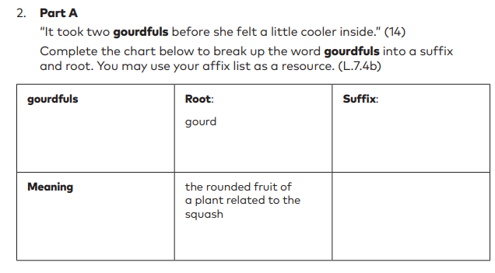
I can identify strategies to determine (figure out) the meaning of unfamiliar vocabulary.
Part B Use what you know about these word parts to write a definition of gourdfuls in your own words. (L.7.4b, L.7.6)
ful
full of

Slide 17
I can identify strategies to determine (figure out) the meaning of unfamiliar vocabulary.
Follow the directions in your workbook to answer questions 3-4 on pages 178-179. Make sure you do both parts of each question.
You do not need to do question 5.

