Slide 1
M1 U1 L02 Establish Reading Routines
I can use evidence from the text to find the gist of chapter 1 of A Long Walk to Water.

Slide 2
Today We Will: | Vocabulary
Opening Becoming Ethical People Reflect on the Module Guiding Questions Work Time Read A Long Walk to Water, chapter 1 Find the Gist: A Long Walk to Water, chapter 1 Closing & Assessment Reflect on Learning Targets Homework Answer Selected Response Questions, chapter 1 Preread Anchor Text chapter 1 | Vocabulary empathy ethical people respect gist

Slide 3
Work to Become Ethical People Anchor Chart
Habit of character | I show respect.
What Does it Mean?
What Does it Look Like?
What does it sound like?
This means I appreciate the abilities, qualities, and achievements of others and treat myself, others and the environment with care
Applauding others when hey have done well
Taking care around the classroom not to break things or hurt people
Returning borrowed items in the same condition you were given them
Throwing trash in the trash can
Recycling
“I really appreciate…because…”
“You did a great job with…because…”

Slide 4
Work to Become Ethical People Anchor Chart
Habit of character | I behave with integrity.
What Does it Mean?
What Does it Look Like?
What does it sound like?
This means I am honest and do the right thing, even when it’s difficult, because it is the right thing to do.
Admitting when at fault
Doing homework
Keeping eyes on own work
“I’m sorry, but I…”

Slide 5
Work to Become Ethical People Anchor Chart
Habit of character | I show empathy
What Does it Mean?
What Does it Look Like?
What does it sound like?
This means I understand and I share or take into account the feelings, situation, or attitude of others.
Listening carefully and showing the appropriate facial expressions for the situation
“I understand how you feel.”
I can imagine how you feel.”

Slide 6
Work to Become Ethical People Anchor Chart
Habit of character | I show compassion
What Does it Mean?
What Does it Look Like?
What does it sound like?
This means I notice when others are sad or upset and try to help them.
Approaching a friend or classmate who looks upset
“You look upset, is everything OK? Is there anything I can do to help?”

Slide 7
Review: Guiding Questions
Who are the Lost Boys of Sudan, and what is their story?
What are the habits of character the Lost Boys used to survive?

Slide 8
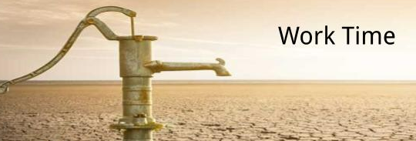
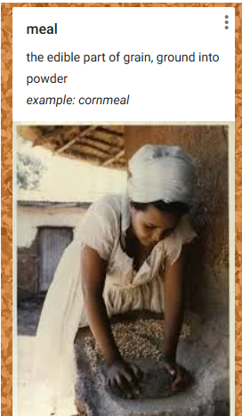
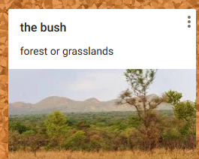
Vocabulary:
• cradle (1): to hold or rock in or as in a cradle
• droned (2): talked in a boring voice without changing one’s tone
• rebels (6): people who fight against or are not loyal to the government of their country

Slide 9
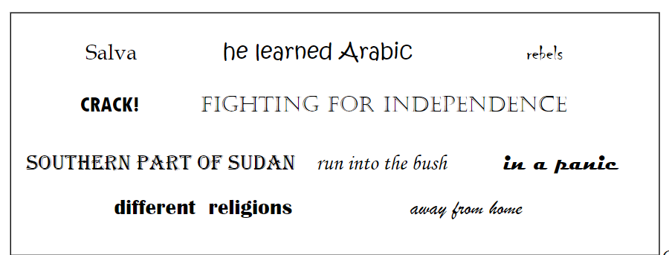
Word Bank Predictions
In the blank space at the bottom of page 4 of your workbook, write down 3 items, and predict what each one might have to do with the events of this chapter.

Slide 10
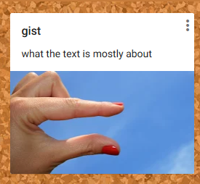
Chapter 1
Click image for audio.
I can use evidence from the text to find the gist
What does gist mean?
It's what the text is mostly about.
Use a very small number of words.
Why is finding the gist important?
It helps us to check our understanding of the text.
Example sentences:
My dad went on and on, but the gist of it was that I was grounded.
Because Maria told her story in a confusing way, I could not get the gist of it.
What was the gist of Nya’s part of the chapter?
What was the gist of Salva's part of the chapter?

Slide 11
I can use evidence from the text to find the gist
What does gist mean?
It's what the text is mostly about.
Use a very small number of words.
What was the gist of Nya’s part of the chapter?
What was the gist of Salva's part of the chapter?
Gists: A Long Walk to Water
Chapter | Nya | Salva
1
walking somewhere with container in the heat
in school, hears gunshots, runs away

Slide 12
Word Bank Predictions – Follow Up
Look at your predictions. Put an * next to the ones that were accurate. Draw a line through inaccurate predictions and revise your statement to make it accurate.

Slide 13
Workbook Pages 175-176

Slide 17
Guiding Questions & Performance Task

