Slide 1
7th Grade English Language Arts (ELA)
M1 U1 L1

Slide 2
What Standards will we focus on in this unit?

Slide 3
M1U1L1 Discover Our Topic: The Lost Boys of Sudan
Today We Will: | Vocabulary:
Opening Engage the Learner Work Time Infer the Topic Introduce the Performance Task and Module Guiding Questions Launch the Text: A Long Walk to Water Closing & Assessment Reflect on Learning Targets Homework Read and reflect Preread Anchor Text chapter 1 | Haven Infer Habits of Character

Slide 4
I can use evidence from resources to infer the topic of this Module.

Slide 5
Unit 1 Workbook, page 3
What do you think you will be learning about?
As we go through each source, jot down your observations and questions.

Slide 6
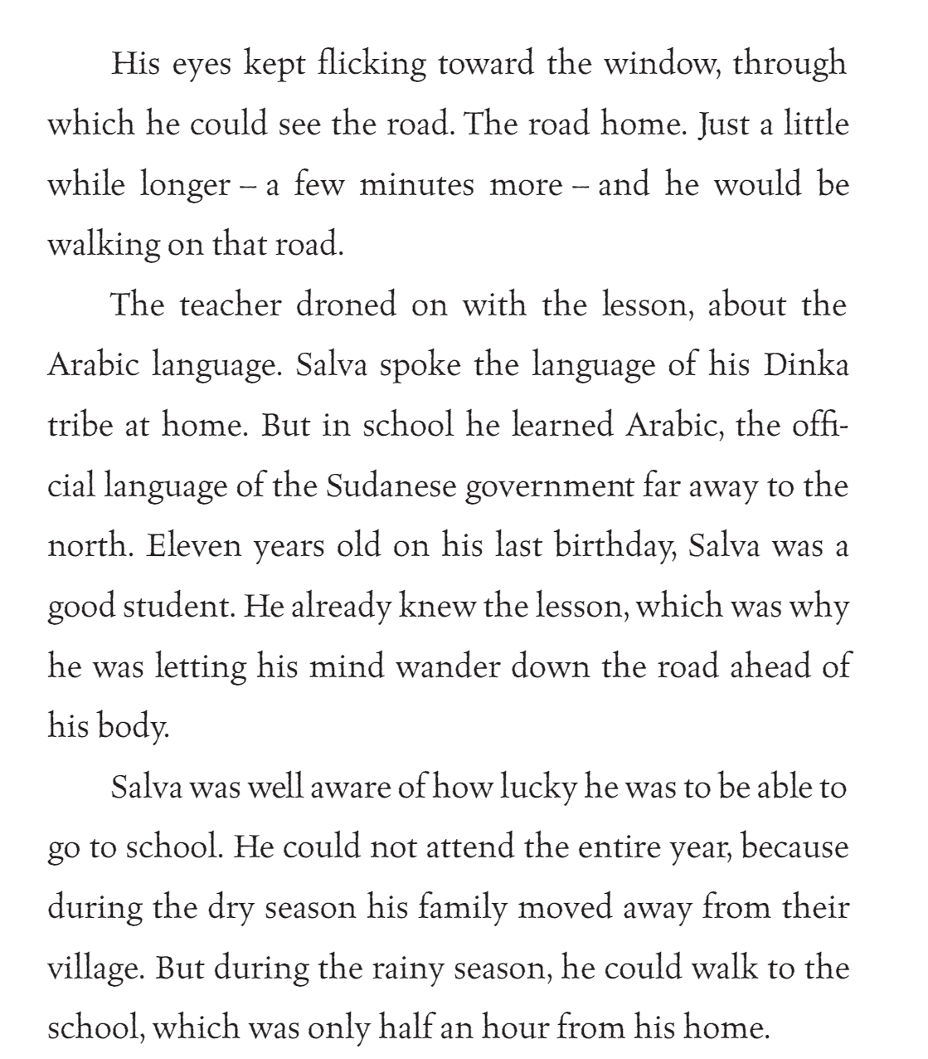
Resource 1
Page 2
A Long Walk to Water: Based on a True Story © 2010 by Linda Sue Park.

Slide 7
Resource 2
Page 7
A Long Walk to Water: Based on a True Story © 2010 by Linda Sue Park.
But the people in the south were of different religions
and did not want to be forced to practice Islam. They began
ﬁghting for independence from the north. The ﬁghting was scattered all around southern Sudan, and now the war
had come to where Salva lived.
The boys scrambled to their feet. Some of them
were crying. The teacher began hurrying the students out
the door.
Salva was near the end of the line. He felt his heart
beating so hard that its pulse pounded in his throat and
ears. He wanted to shout, ‘I need to go home! I must go
home!’ But the words were blocked by the wild thumping
in his throat.
When he got to the door, he looked out. Everyone
was running – men, children, women carrying babies.
The air was full of dust that had been kicked up by all
those running feet. Some of the men were shouting and
waving guns.
Salva saw all this with one glance.
Then he was running, too. Running as hard as he
could, into the bush.
Away from home.

Slide 8
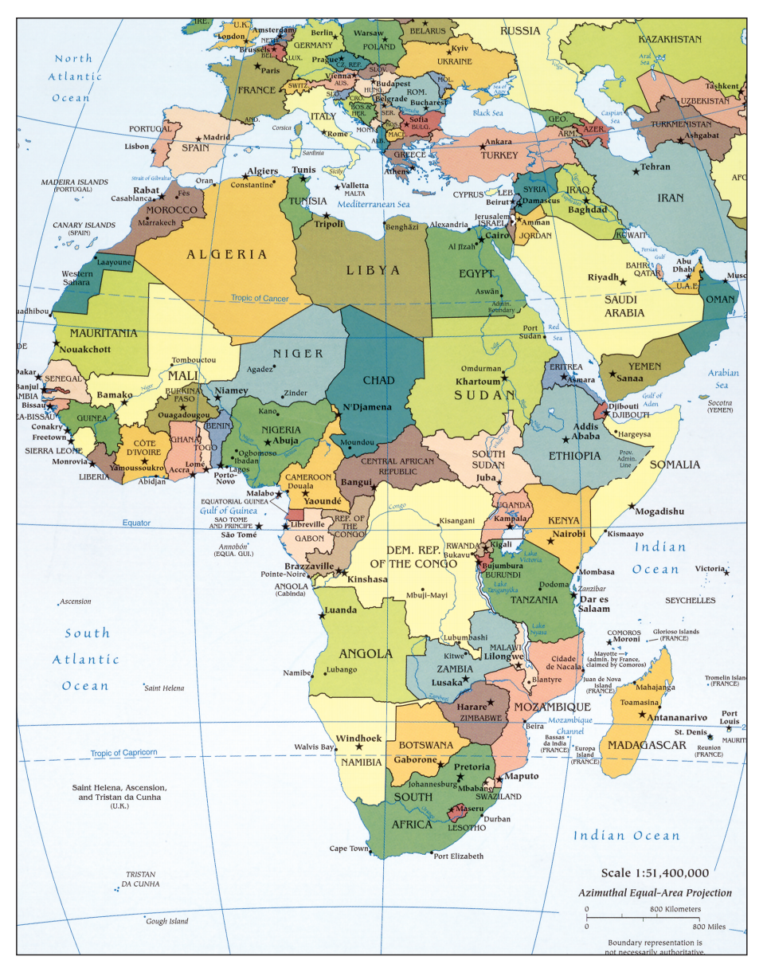
Resource 3
Central Intelligence Agency. “Africa.” Map. 2011. Library of Congress. Web. Public domain.

Slide 9
Resource 4

Slide 10
Resource 5
Lindasuepark.com

Slide 11
Use resources to Infer the Topic
Look over your “I Notice, I Wonder” note-catcher.
Based on your observation, what can you infer this Module might be about?
Use the sentence starters to help you phrase your thinking:
Based on ____, I can infer that this module will be about _____ because…

Slide 12
Let’s explore our anchor text
Take a couple of minutes to examine the novel, A Long Walk to Water.
Examine the front and back covers
Flip through and examine the text
What are some observations you have made while examining the text?

Slide 13
Guiding Questions & Performance Task

